Slide 1
Customer Churn Analysis Presentation

Slide 2
Project analysis slide 2
Project Analysis
PROBLEM STATEMENT
In last Financial Year, Capstone bank observed customer churn, for which management hired some analytical specialists to find solutions.
Their aim is to reduce the customer churn, improves the service delivery and enhance customer satisfaction.

Slide 3
Project analysis slide 3
Project Analysis
OBJECTIVE
IDENTIFY LOCATIONS
AND GENDER WHERE CHURN RATE IS MORE
ANALYZING THE CUSTOMER SEGMENTS FOR POTENTIAL CHURN
PROPOSE MEASURES
TO RETAIN CUSTOMERS FROM CHURN

Slide 4
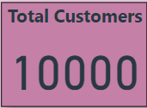
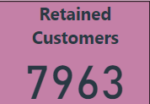
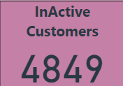
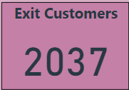
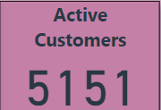
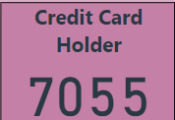
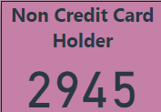
Project analysis slide 4
Project Analysis
KEY METRICS

Slide 5
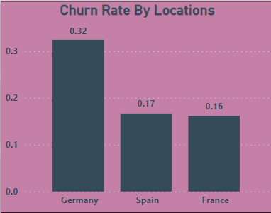
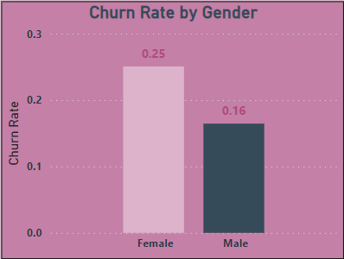
Project analysis slide 5
Project Analysis
IDENTIFY LOCATIONS
AND GENDER WHERE CHURN RATE IS MORE
Insights: From the geography locations in the dataset, Germany has high churn rate compare to other countries.
Female customers have high churn rate compare to male customers

Slide 6
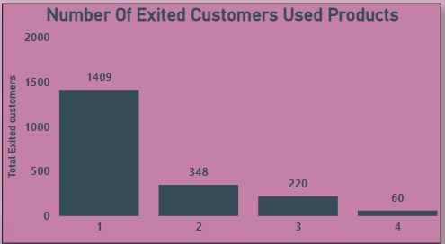

Project analysis slide 5
Project Analysis
ANALYZING THE CUSTOMER SEGMENTS FOR POTENTIAL CHURN
Insights: Excited customers used only one product of the bank which makes a potential customer segment for churn.
Also credit score comes in poor category have highest churn rate which is 0.218 that could be a potential churn category.

Slide 7
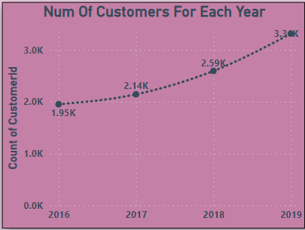
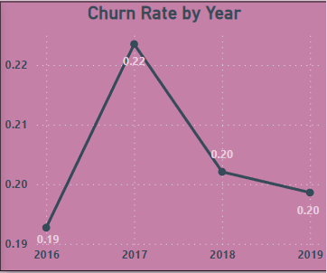
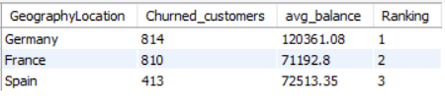
Project analysis slide 5
Project Analysis
PROPOSE MEASURES
TO DECREASE CHURN RATE
Insights: Number of customers joining the bank increases year to year which is good sign as well the churn rate also decreases year to year. Take necessary steps to increase the joining of customers every year from which we can decrease the churn rate. Also focus on country like Germany and France to take marketing measures to reduce chur rate as they have high churned customers 841 and 810 respectively.

Slide 8
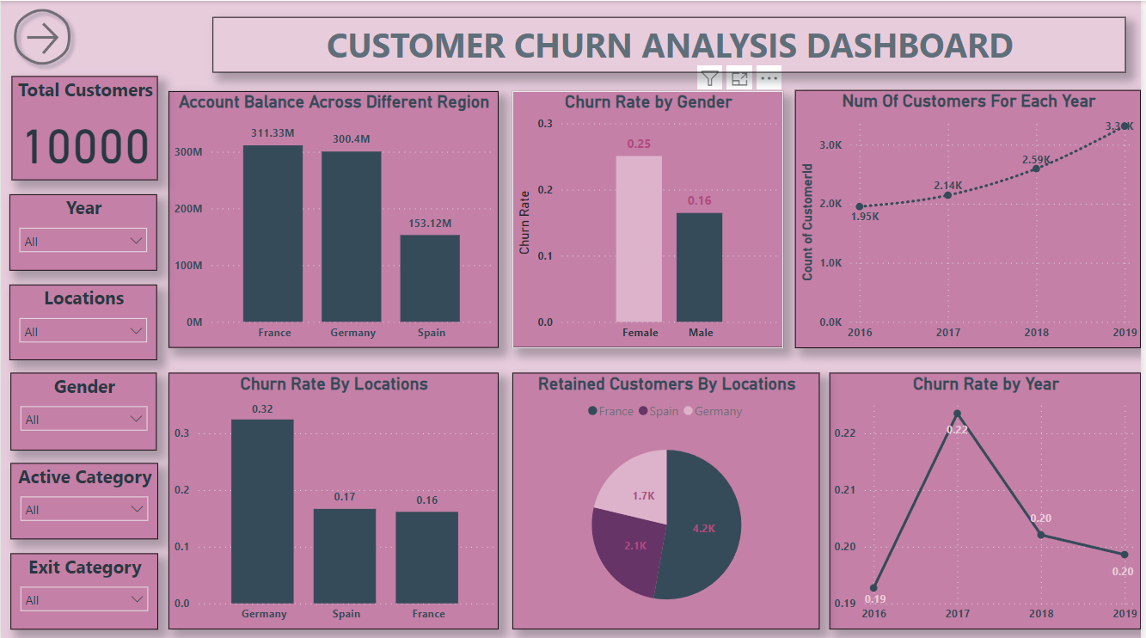
Project analysis slide 5
REPORTS

Slide 9
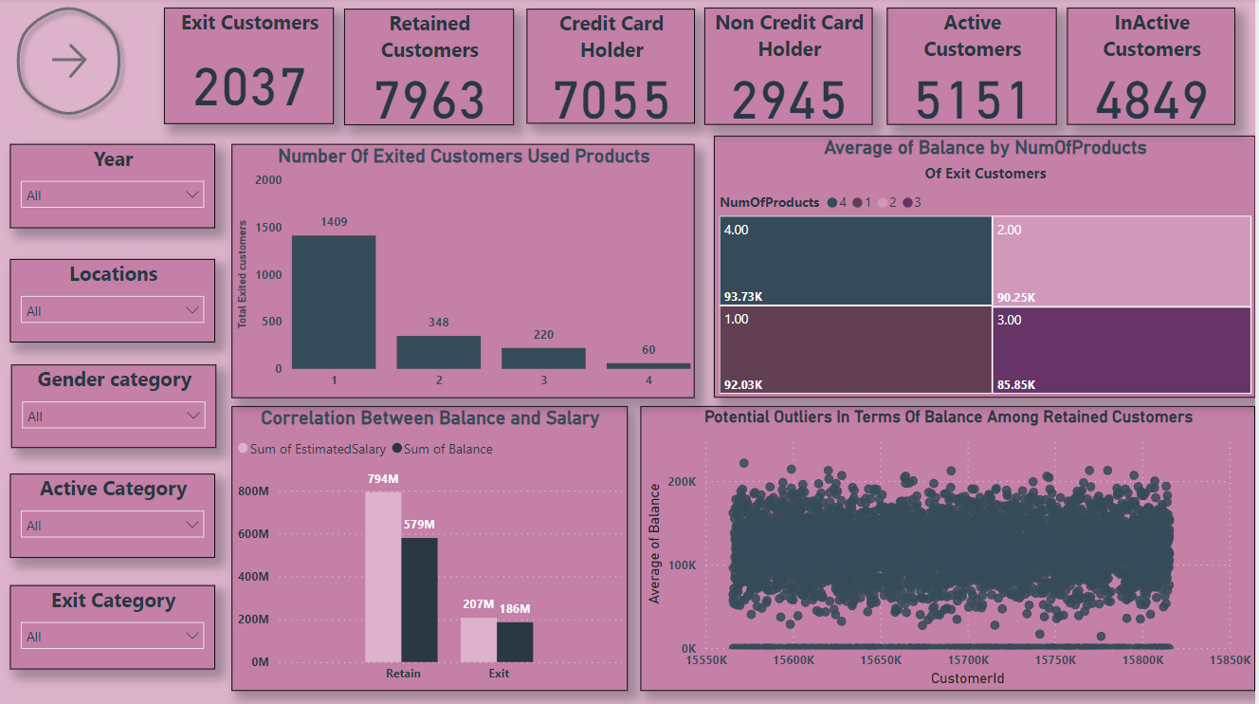
Project analysis slide 5
REPORTS

Slide 10
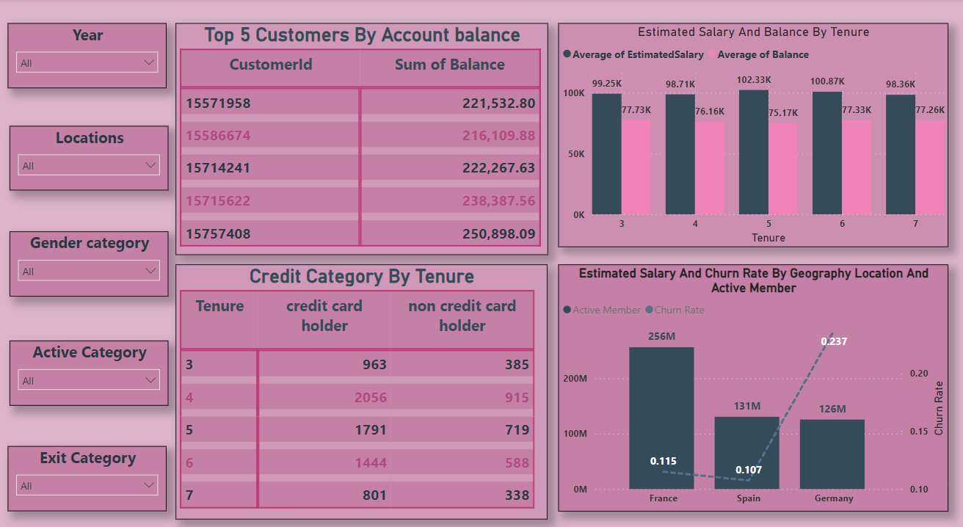
Project analysis slide 5
REPORTS

Slide 11
Thank You

